Slide 1
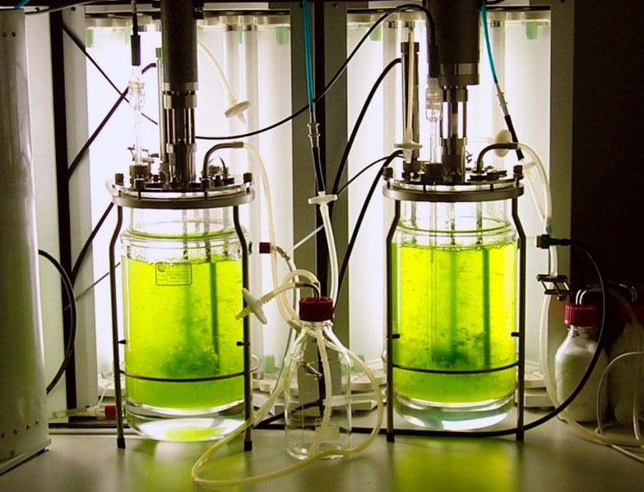
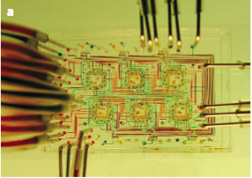

Of Bioreactors A. Khaliqi, S. Azimi and M.A. Adibi
Spring 2011

Slide 2
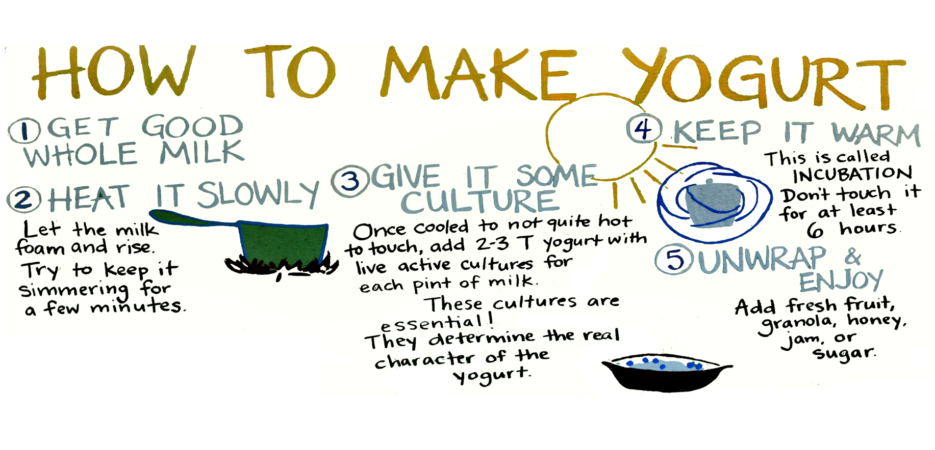
Traditional Bioreactors

Slide 3
Traditional Bioreactors
Milk is mainly composed of a protein called Casein.
Two bacteria, called Streptococcus thermophilus and Lactobacillus bulgaricus are responsible for turning milk into yogurt at 42 °C
By producing lactic acid, they lower pH of milk. As soon as the solution reaches isoelectric pH, it coagulates.
The vessel in which yogurt is made, is effectively a bioreactor. :)

Slide 4
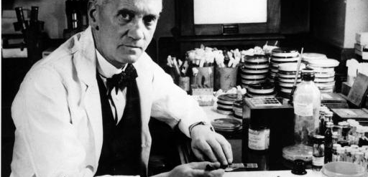
17 years of penicillin process development: the epic of the winning turtle

Slide 5
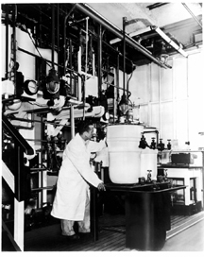
17 years of penicillin process development: the epic of the winning turtle

Slide 6
Em? bioreactor?!
A bioreactor is a vessel in which we grow cells.
The cells can be either Bacteria, Fungi or Yeast
Mammalian Cells, Plant Cells
Fermenters
Bioreactors

Slide 7
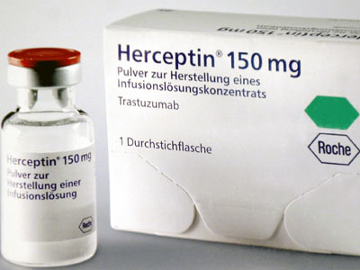
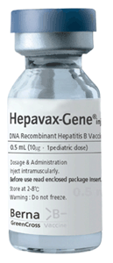
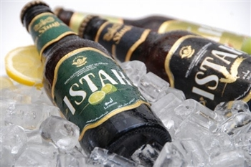
Why do we grow cells?
To produce:
Stem Cells
Vaccines
Antibiotics
Antibodies
Other RPs
Diary products (Yogurt, Cheese(
etc.
To test drugs
And in order to grow tissues

Slide 8
What do cells need?
Food: Glucose, Amino Acids, Growth Factors, Hormones, etc.
Oxygen
Fixed pH: Normally at about 7.2
Fixed Temperature: Normally at about 37°C

Slide 9
Types of bioreactors
Disposable, Sophisticated, Passive and Active Agitation, Industrial Bioreactors, Mini-Bioreactors, Microbioreactors

Slide 10
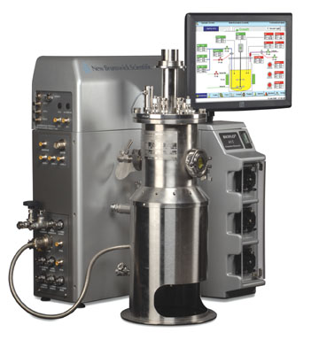
Types of bioreactors

Slide 11
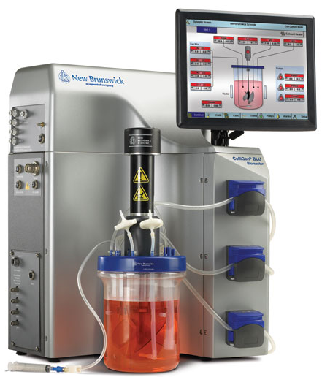
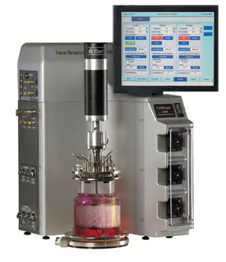
Types of bioreactors

Slide 12
How do we respond?
Food -> Culture Media: RPMI1640, DMEM, SFMs
Food -> Fetal Bovine Serum

Slide 13
Bioreactor Parts
The Vessel
The Agitation System
The Aeration System
Thermal Jacket
PID Control System (Which controls O2 Level, pH and Temperature)

Slide 14
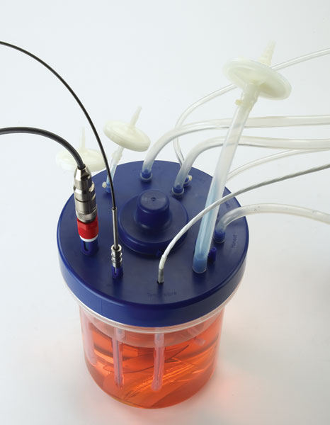
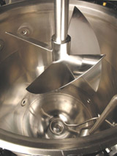
Bioreactors Parts

Slide 15
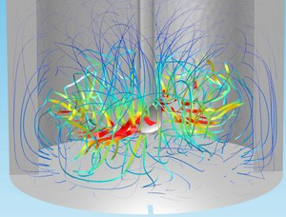
Design of Stirred Bioreactors

Slide 16
Practical issues
Down Stream Process Difficulties: The Serum Problem
Unsteadiness – Cell Growth cycle
The Optimum Production (Secondary and tertiary products)

Slide 17
Optimization
pH. Temperature, Agitation, Serum Content, O₂ Flow Rate

